Slide 1
Chapter 8
Adding a Disk

Slide 2
Disk Interface
SCSI
  Small Computer Systems Interface
  High performance and reliability
IDE (or ATA)
  Integrated Device Electronics (or AT Attachment)
  Low cost
  Become acceptable for enterprise with the help of RAID technology
SATA
  Serial ATA
SAS
  Serial Attached SCSI
USB
  Universal Serial Bus
  Convenient to use

Slide 3
Disk Interface –
SCSI Interface Evolution
Version | Freq. | Width | Speed | Length | Diff.
SCSI-1 | 5MHz | 8 bits | 5MB/s | 6m | 25m
SCSI-2 | 5MHz | 8 bits | 5MB/s | 6m | 25m
SCSI-2 Fast | 10MHz | 8 bits | 10MB/s | 3m | 25m
SCSI-2 Fast Wide | 10MHz | 16 bits | 20MB/s | 3m | 25m
Ultra SCSI | 20MHz | 8 bits | 20MB/s | 1.5m | 25m
Ultra Wide SCSI | 20MHz | 16 bits | 40MB/s | 1.5m | 25m
Ultra2 SCSI | 40MHz | 16 bits | 80MB/s | - | 12m
Ultra160 SCSI | 80MHz | 16 bits | 160MB/s | - | 12m
Ultra320 SCSI | 160MHz | 16 bits | 320MB/s | - | 12m

Slide 4
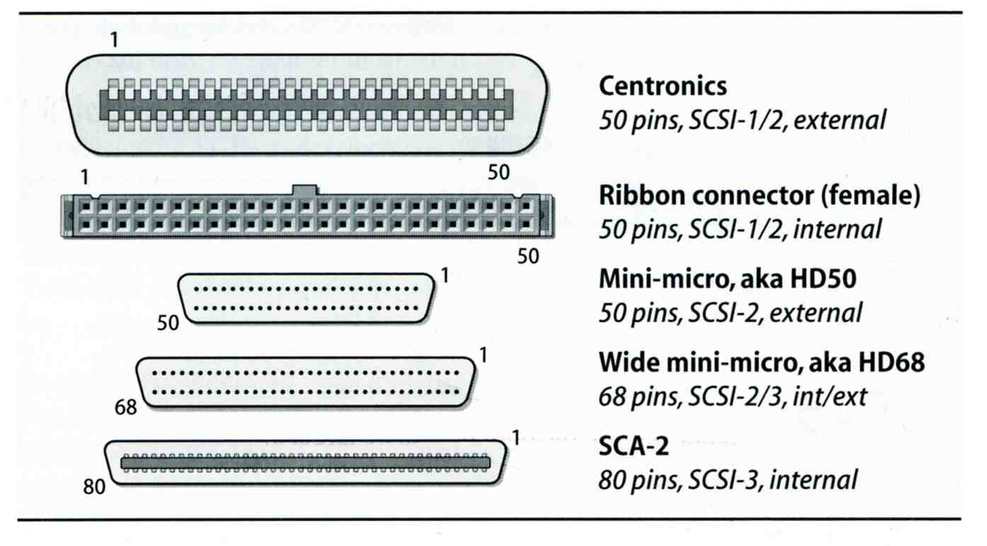
Disk Interface –
SCSI Interface Connector

Slide 5
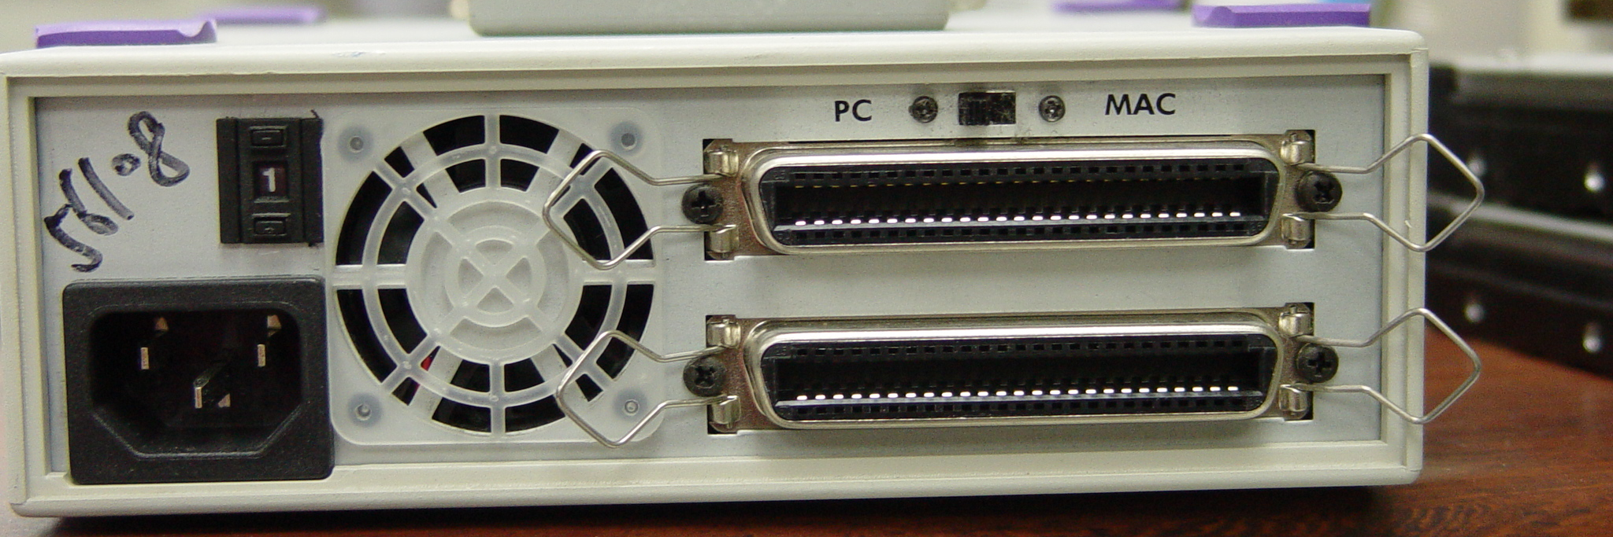
Disk Interface –
SCSI Interface
Daisy chain on SCSI bus
  Most external devices have two SCSI ports
  Terminator
Each SCSI device has a SCSI ID

Slide 6
Disk Interface –
ATA & SATA
ATA (AT Attachment)
  ATA2
    PIO, DMA
    LBA (Logical Block Addressing)
  ATA3, Ultra DMA/33/66/100/133
  ATAPI (ATA Packet Interface)
    CDROM, TAP
  Only one device can be active at a time
    SCSI support overlapping commands, command queuing, scatter-gather I/O
  Master-Slave
  40-pin ribbon cable
SATA
  Serial ATA

Slide 7
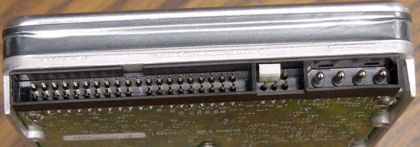
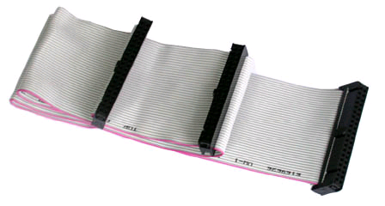
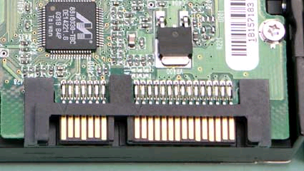
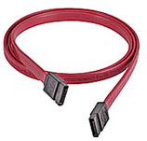
Disk Interface –
ATA & SATA Interface
ATA interface and it’s cable
SATA interface and it’s cable

Slide 8
Disk Interface –
SAS
SAS – Serial Attached SCSI
SAS vs parallel SCSI
  SAS uses Serial transfer protocol to interface multiple devices hence lesser signaling overhead than parallel SCSI, resulting in higher speed.
  No bus contention as SAS bus is point-to-point while SCSI bus is multidrop. Each device is connected by a dedicated bus to the initiator. Connection through expanders may appear to cause some contention, but this is transparent to the initiator.
  SAS has no termination issues and does not require terminator packs like parallel SCSI.
  SAS eliminates skew.
  SAS supports higher number of devices (> 16384) while Parallel SCSI limits it to 16 or 32.
  SAS supports higher transfer speed (1.5, 3.0 or 6.0 Gbps). The speed is realized on each initiator-target connection, hence higher throughput whereas in parallel SCSI the speed is shared across the entire multidrop bus.
  SAS supports SATA devices.
  SAS uses SCSI commands to interface with SAS End devices.

Slide 9
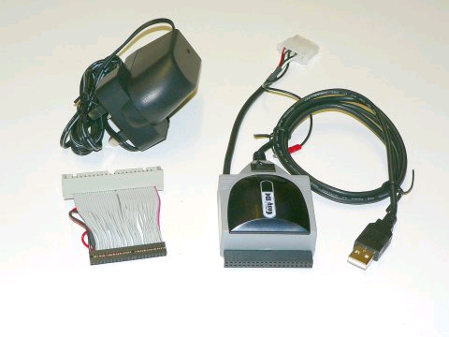
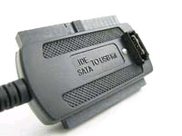
Disk Interface –
USB
USB to IDE/SATA
Converter

Slide 10
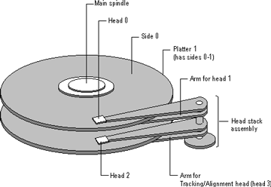
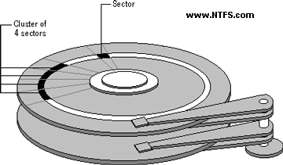
Disk Geometry (1)
sector
  Individual data block
track
  circle
cylinder
  circle on all platters
Position
  CHS
  Cylinder, Head, Sector

Slide 11
Disk Geometry (2)
40G HD
  4866 cylinders, 255 heads
  63 sectors per track, 512 bytes per sector
  512 * 63 * 4866 * 255 = 40,024,212,480 bytes
  1KB = 1024 bytes
  1MB = 1024 KB = 1,048,576 bytes
  1GB = 1024 MB = 1,073,741,824 bytes
  42,278,584,320 / 1,073,741,824 ≒ 39.375 GB

Slide 12
Disk Installation Procedure (1)
The procedure involves the following steps:
  Connecting the disk to the computer
    IDE: master/slave
    SCSI: ID, terminator
    power
  Creating device files
    /dev
    Now auto created by devfs (man defvs)
  Formatting the disk
    Low-level format
      Address information and timing marks on platters
      bad sectors
    Manufacturer diagnostic utility

Slide 13
Disk Installation Procedure (2)
  Partitioning and Labeling the disk
    Allow the disk to be treated as a group of independent data area
    root, home, swap partitions
    Suggestion:
      /var, /tmp ➔ separate partition
      Make a copy of root filesystem for emergency
  Establishing logical volumes
    Combine multiple partitions into a logical volume
    Software RAID technology
      FreeBSD (gvinum)
      Linux (Linux LVM)
      Sun (Solstice Disk Suite)

Slide 14
Disk Installation Procedure (3)
  Creating UNIX filesystems within disk partitions
    Use “newfs” to install a filesystem for a partition
    Filesystem components
      A set of inode storage cells
      A set of data blocks
      A set of superblocks
      A map of the disk blocks in the filesystem
      A block usage summary

Slide 15
Disk Installation Procedure (4)
    Superblock contents
      The length of a disk block
      Inode table’s size and location
      Disk block map
      Usage information
      Other filesystem’s parameters
    ※ sync system call
    Flush the cashed superblocks in-memory copy to the permanent place in disk

Slide 16
Disk Installation Procedure (5)
  mount
    Bring the new partition to the filesystem tree
    mount point can be any directory
    % mount /dev/ad1s1e /home2
  Setting up automatic mounting
    Automount at boot time
      /etc/fstab
      % mount –t ufs /dev/ad2s1a /backup
      % mount –t cd9600 –o ro,noauto /dev/acd0c /cdrom
chwong@sabsd:/etc> less fstab
# Device Mountpoint FStype Options Dump Pass#
/dev/ad0s1b none swap sw 0 0
/dev/ad2s1b none swap sw 0 0
/dev/ad0s1a / ufs rw 1 1
/dev/acd0c /cdrom cd9660 ro,noauto 0 0
proc /proc procfs rw 0 0
/dev/ad2s1a /backup ufs rw,noauto 1 1
ccduty:/bsdhome /bsdhome nfs rw,noauto 0 0

Slide 17
Disk Installation Procedure (6)
  Setting up swapping on swap partitions
    swapon command

Slide 18
fsck – check and repair filesystem (1)
System crash will cause
  Inconsistency between memory image and disk contents
fsck –p
  Examine all local filesystem listed in /etc/fstab at boot time
  Automatically correct the following damages:
    Unreferenced inodes
    Inexplicably large link counts
    Unused data blocks not recorded in block maps
    Data blocks listed as free but used in file
    Incorrect summary information in the superblock

Slide 19
fsck – check and repair filesystem (2)
Run fsck in manual to fix serious damages
  Blocks claimed by more than one file
  Blocks claimed outside the range of the filesystem
  Link counts that are too small
  Blocks that are not accounted for
  Directories that refer to unallocated inodes
  Other errors
fsck will suggest you the action to perform
  Delete, repair, …

Slide 20
Adding a disk to FreeBSD (1)
Check disk connection
  Look system boot message
Use /stand/sysinstall to install the new HD
  Configure → Fdisk → Label
  Don’t forget to “W” the actions
Make mount point and mount it
  % mkdir /home2
  % mount –t ufs /dev/ad3s1e /home2
  % df
Edit /etc/fstab
ad3: 16383MB <Virtual HD> [33288/16/63] at ata1-slave WDMA2

Slide 21
Adding a disk to FreeBSD (2)
If you forget to enable soft-update when you add the disk
  % umount /home2
  % tunefs –n enable /dev/ad3s1e
  % mount –t ufs /dev/ad3s1e /home2
  % mount
/dev/ad0s1a on / (ufs, local, soft-updates)
/dev/ad1s1e on /home (ufs, local, soft-updates)
procfs on /proc (procfs, local)
/dev/ad3s1e on /home2 (ufs, local, soft-updates)

Slide 22
RAID (1/2)
Redundant Array of Inexpensive Disks
  A method to combine several physical hard drives into one logical unit
Depending on the type of RAID, it has the following benefits:
  Fault tolerance
  Higher throughput
  Real-time data recovery
RAID Level
  RAID 0, 1, 0+1, 2, 3, 4, 5, 6
  Hierarchical RAID

Slide 23
RAID (2/2)
Hardware RAID
  There is a dedicate controller to take over the whole business
  RAID Configuration Utility after BIOS
    Create RAID array, build Array
Software RAID
    FreeBSD (gvinum)
    Linux (Linux LVM)
    Sun (Solstice Disk Suite)

Slide 24
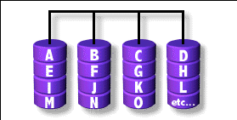
RAID 0
Stripped data intro several disks
Minimum number of drives: 2
Advantage
  Performance increase in proportional to n theoretically
  Simple to implement
Disadvantage
  No fault tolerance
Recommended applications
  Non-critical data storage
  Application requiring high bandwidth (such as video editing)

Slide 25
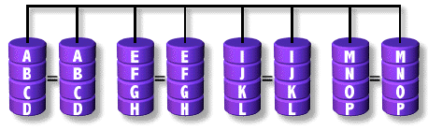
RAID 1
Mirror data into several disks
Minimum number of drives: 2
Advantage
  100% redundancy of data
Disadvantage
  100% storage overage
  Moderately slower write performance
Recommended application
  Application requiring very high availability (such as home)

Slide 26
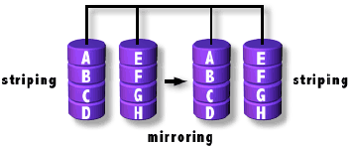
RAID 0+1
Combine RAID 0 and RAID 1
Minimum number of drives: 4

Slide 27
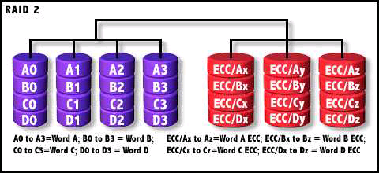
RAID 2
Hamming Code ECC Each bit of data word
Advantages:
  "On the fly" data error correction
Disadvantages:
  Inefficient
  Very high ratio of ECC disks to data disks
Recommended Application
  No commercial implementations exist / not commercially viable

Slide 28
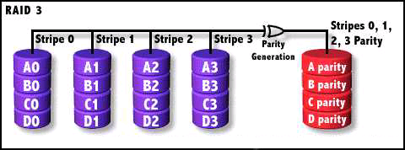
RAID 3
Parallel transfer with Parity
Minimum number of drives: 3
Advantages:
  Very high data transfer rate
Disadvantages:
  Transaction rate equal to that of a single disk drive at best
Recommended Application
  Any application requiring high throughput

Slide 29
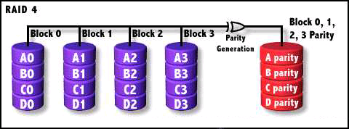
RAID 4
Similar to RAID3
RAID 3 V.S RAID 4
  Byte Level V.S Block Level

Slide 30
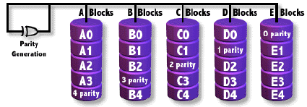
RAID 5
Independent Disk with distributed parity blocks
Minimum number of drives: 3
Advantage
  Highest read data rate
  Medium write data rate
Disadvantage
  Disk failure has a medium impact on throughput
  Complex controller design
  When one disk failed, you have to rebuild the RAID array

Slide 31
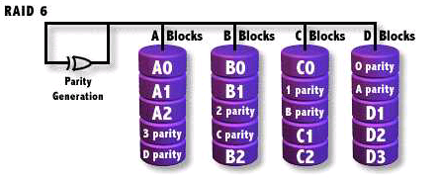
RAID 6
Similar to RAID5
Minimum number of drives: 4
2 parity checks, 2 disk failures tolerable.

